Slide 1
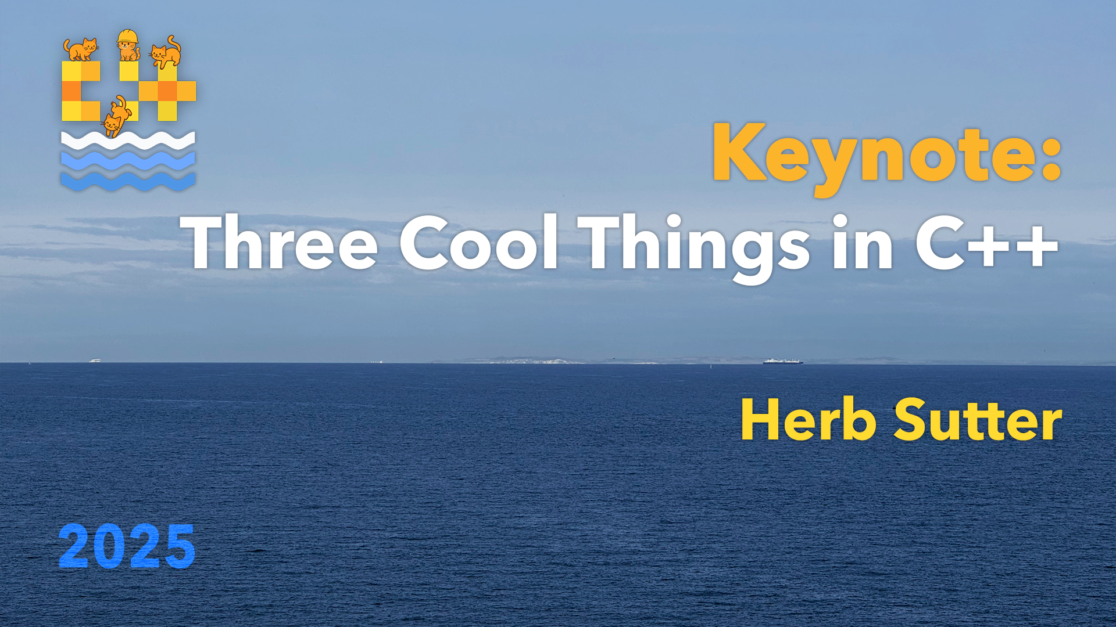

Slide 2
Three Cool Things in C++
Thing 1
≈ £0
Thing 2
Thing 3
Thing 3
Thing 3
Thing 3
Thing 3

Slide 3
Three Cool Things in C++
Thing 2
Thing 1
≈ £0
Thing 3
Thing 3
Thing 3
Thing 3
Thing 3

Slide 4
Three Cool Things in C++
Thing 2
Thing 1
≈ £0
Thing 3
Thing 3
Thing 3
Thing 3
Thing 3

Slide 5



C++26: “erroneous behavior”
Undefined behavior means “anything can happen”
Usual examples nasal daemons, format c:
Actual bad examples time travel, leaking secrets
C++26 introduces a new tool: erroneous behavior
“Well-defined as being Just Wrong”
Not undefined ⇒ no time travel, or leaked secrets!
A general tool, but first applied to…
Reading uninitialized local variables is not undefined behavior in C++26!
A C++26 compiler is required to write an “erroneous” value

Slide 6
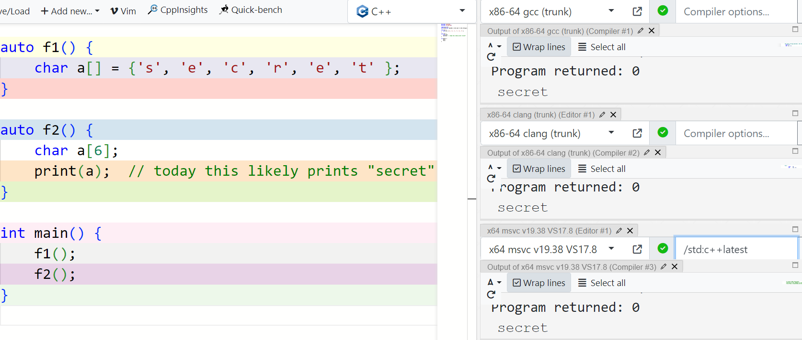

Slide 7
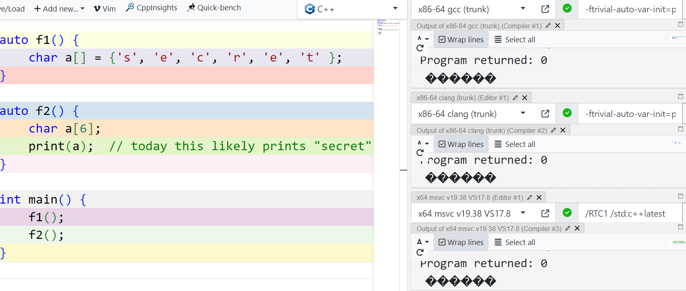

Slide 8
C++26: Standard library hardening
C++26 “stdlib hardening” adds bounds checking for common std:: type operations:
Sequence containers operator[], front, back, pop_front, pop_back
(e.g., vector, array)
string family operator[], front, back, pop_back
string_view family operator[], front, back, remove_prefix, remove_suffix
span operator[], front, back, first, last, subspan, constructors
mdspan operator[], constructors
bitset operator[]
valarray operator[]
And null/empty checking for:
optional operator->, operator*
expected operator->, operator*, error

Slide 9
From the Apple paper…
“
We have experience deploying hardening on Apple platforms…
Google … deploy[ed] this very technology to hundreds of millions of lines of code [with] a performance impact as low as 0.3% and finding over 1000 bugs, including security-critical ones.
[In 2024] Google Andromeda published … their success… enabling hardening.
The libc++ maintainers have received numerous informal reports of hardening being turned on and helping find bugs in codebases.
Overall, standard library hardening has been a huge success, in fact we never expected so much success. The reception has been overwhelmingly positive and while the quality of implementation will never be perfect, we are working hard to expand the scope of hardening in libc++, to improve its performance and the user experience.

Slide 10
C++26 trivial relocation
“Trivial” = just copy the bits smartly (e.g., signing vptrs, special safety sauce)
“Relocation” = atomically create a new object and end the lifetime of an old object, moving the contents (aka ‘destructive move’)
Skips checks + extra branches in the destructor = faster than move
✓✓✓ All trivially copyable types are now also trivially relocatable
Existing pre-standard uses: BSL (Bloomberg), Qt, Folly, libc++
But more limited, and rely on UB – people are doing it anyway for the perf boost
Example: This code will get faster when recompiled as C++26 (once your stdlib implementation has been suitably updated)
std::vector< std::vector< int > > vv;
while (a_long_time) { vv.push_back( {1} ); }
if there’s no explicitly deleted move ctor
Recall C++11 move semantics: “recompile and your code is a bit faster”

Slide 11
C++26: “EB” + stdlib hardening + relocation
Pause a moment and consider how this is important:
Quantitatively Automatically eliminates a significant fraction (5%? 10%?) of vulnerabilities and other bugs + some % speedup
Qualitatively Delivered to existing code with no manual code changes, just a recompile
⇒ seriousness about adoptability & improving existing code

Slide 12
Three Cool Things in C++
Thing 2
Thing 1
≈ £0
Thing 3
Thing 3
Thing 3
Thing 3
Thing 3

Slide 13
Three Cool Things in C++
Thing 2
Thing 1
≈ £0
Thing 3
Thing 3
Thing 3
Thing 3
Thing 3

Slide 14

static ⇒ zero runtime overhead
not run-time reflection (this is not Java or C#)
of course, to use some information at run time, just store it!
short definition
the program can see itself and generate itself
… hence, metaprograms

Slide 15

in Sofia a few days ago…
Dan Katz: “Reflection is on track to make C++26 this week!”
Hana Dusíková: (little shrug) “Whole new language.”
(deadpan, little shrug) “Whole new language.”

Slide 16





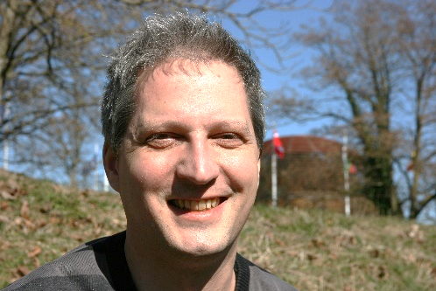
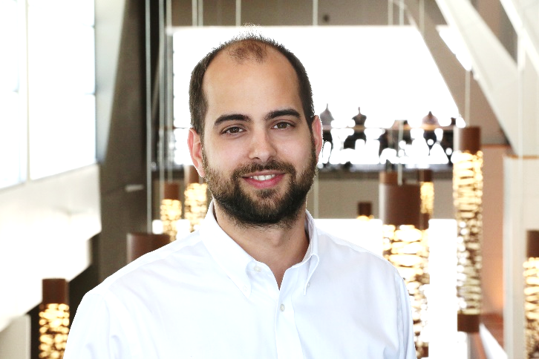


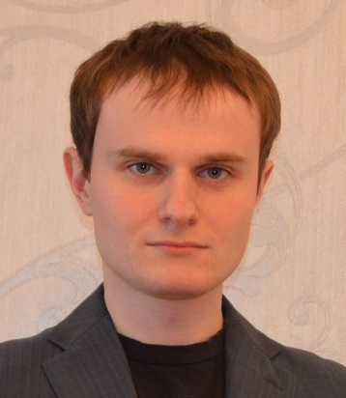
Reflection papers & contributors
Too many to list!
Some notable contributors…
Many reviewers
(Thanks!)
Wyatt Childers (Lock3, EDG)
Barry Revzin
(Jump Trading)
Andrew Sutton (U. Akron, Lock3)
Matúš Chochlík (GlobalLogic)
Axel Naumann (CERN)
David Sankel (Bloomberg)
Daveed Vandevoorde (EDG)
Louis Dionne (Amazon, Apple)
Antony Polukhin (Yandex)

Slide 17



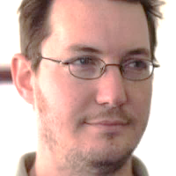

Reflection implementations that now track P2996
2018-2022: Internal EDG prototype 2023-now: Public EDG prototype
by Daveed Vandevoorde
funded by EDG
2017-2020: First Clang prototype
by Lock3 (Andrew Sutton et al.)
funded by Microsoft, Standard C++ Foundation, Herb Sutter
2023-now: Second Clang prototype
by Dan Katz, using first as starting point
funded by Bloomberg
Clang
EDG
EDG
Clang

Slide 18

ISO C++ & reflection
…
more code generation/inj
…
some code generation/injection
…
… reflect more and more things …
Pnnnn
annotations for reflection
P2996
reflection, splicers, basic metafunctions

Slide 19
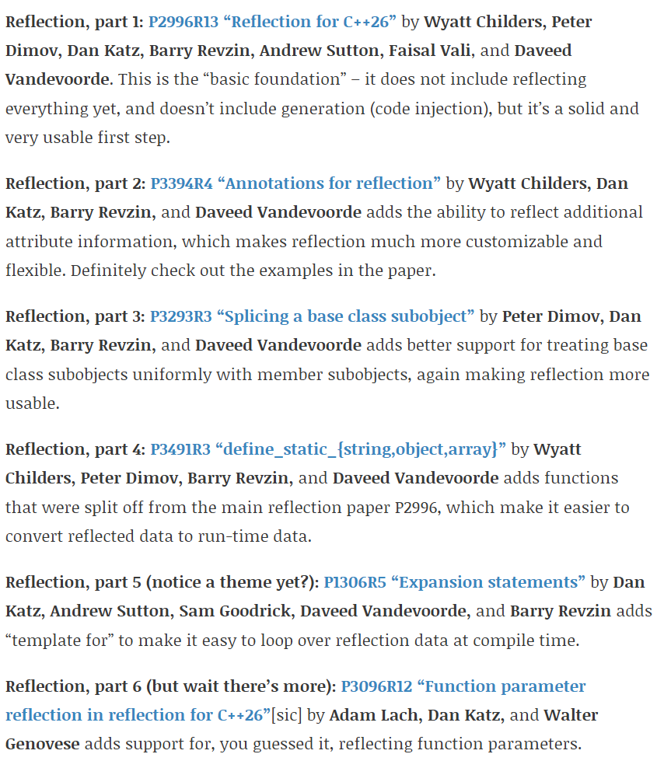
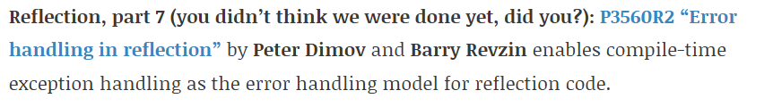
Adopted 48 hours ago (see my blog)

Slide 20
Adopted 48 hours ago (see my blog)

Slide 21
part of 30+-year tide → compile-time meta programming in C++
“The world’s big things only can be done by paying attention to their humble beginnings.” — Lao Tzu

Slide 22
Quick refresher example
class IFoo {
public:
virtual int f() = 0;
virtual void g(std::string) = 0;
virtual ~IFoo() = default;
IFoo() = default;
IFoo(IFoo const&) = delete;
void operator=(IFoo const&) = delete;
};
class(interface) IFoo {
int f();
void g(std::string);
};
declaring our intent
the right defaults
⇒ generated functions
⇒ checked constraints

Slide 23
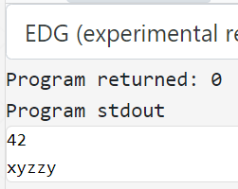
Now in EDG… godbolt.org/z/rvdabTb5M
// P0707 proposed sugar
class(interface) Widget {
int f();
void g(std::string);
};
NOT C++26
(likely C++29)
namespace __proto {
class Widget {
int f();
void g(std::string);
};
}
consteval { interface(^^__proto::Widget); }
class MyWidget : public Widget {
public:
int f() override { return 42; }
void g(std::string s) override { std::cout << s; }
};
int main() {
unique_ptr<Widget> w = make_unique<MyWidget>();
cout << w->f() << '\n';
w->g( "xyzzy" );
}

Slide 24
Now in EDG… godbolt.org/z/rvdabTb5M
NOT C++26
(likely C++29)
consteval void interface(std::meta::info proto) {
std::string_view name = identifier_of(proto);
queue_injection(^^{
class \id(name) {
public:
\tokens(make_interface_functions(proto))
virtual ~\id(name)() = default;
\id(name)() = default;
\id(name)(\id(name) const&) = delete;
void operator=(\id(name) const&) = delete;
};
});
}
composable ✓

Slide 25
Now in EDG… godbolt.org/z/rvdabTb5M
consteval auto make_interface_functions(info proto) -> info {
info ret = ^^{};
for (info mem : members_of(proto)) {
if (is_nonspecial_member_function(mem)) {
ret = ^^{
\tokens(ret)
virtual [:\(return_type_of(mem)):]
\id(identifier_of(mem)) (\tokens(parameter_list_of(mem))) = 0;
};
}
else if (is_variable(mem)) {
// --- reporting compile time errors not yet implemented ---
// print_error( "interfaces may not contain data members" );
}
// etc. for other kinds of interface constraint checks
}
return ret;
}
NOT C++26
(likely C++29)

Slide 26
RECALL
TRICK QUESTION
Does C++26 support reflection with generation (the ability to generate additional new C++ code)?
If so, how and with what limitations?
…
more code generation/inj
…
some code generation/injection
…
… reflect more and more things …
Pnnnn
annotations for reflection
P2996
reflection, splicers, basic metafunctions

Slide 27
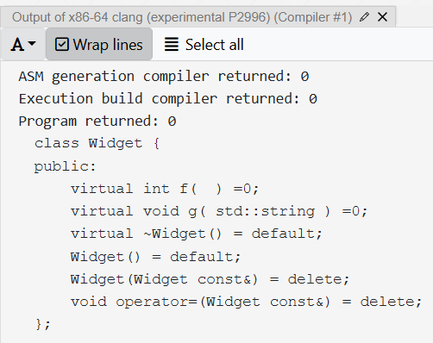
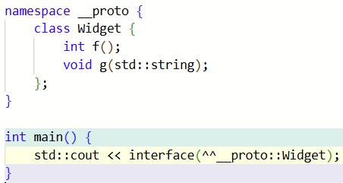
The power of I/O godbolt.org/z/xYhxKo9Wf

Slide 28
Now in C++26… godbolt.org/z/xYhxKo9Wf
YES, C++26! 🥳🎉
namespace __proto {
class Widget {
int f();
void g(std::string);
};
}
std::cout << interface(^^__proto::Widget);
class MyWidget : public Widget {
public:
int f() override { return 42; }
void g(std::string s) override { std::cout << s; }
};
int main() {
unique_ptr<Widget> w = make_unique<MyWidget>();
cout << w->f() << '\n';
w->g( "xyzzy" );
}
consumed in a separate source file

Slide 29
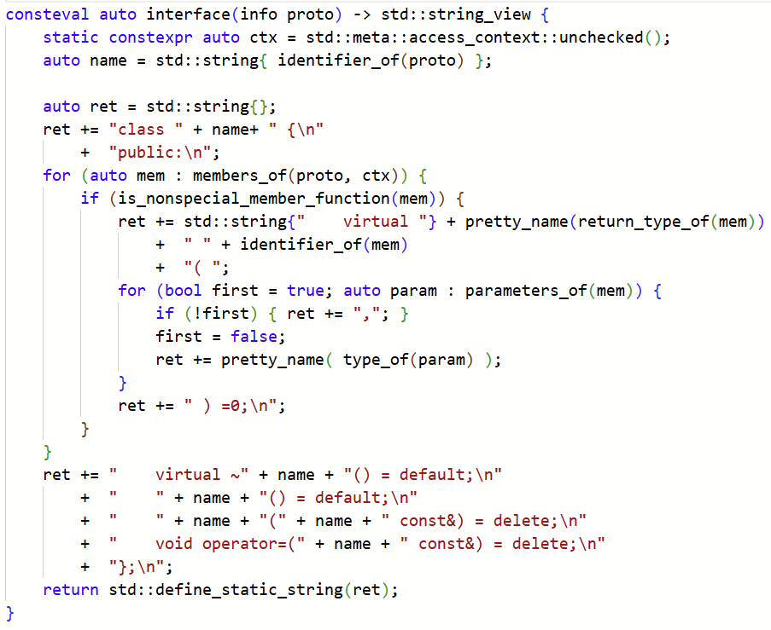
Now in C++26… godbolt.org/z/xYhxKo9Wf
YES, C++26! 🥳🎉

Slide 30
Now in C++26… godbolt.org/z/xYhxKo9Wf
YES, C++26! 🥳🎉

Slide 31
In the box with cppfront so far… all build to pure ISO C++ & work with GCC/Clang/MSVC
interface An abstract class having only pure virtual functions
polymorphic_base A pure polymorphic base type that is not copyable or movable, and whose destructor is either public+virtual or protected+nonvirtual
ordered A totally ordered type with operator<=> that implements strong_ordering. Also: weakly_ordered, partially_ordered
copyable A type that has copy/move construction/assignment
basic_value A copyable type that has public default construction and destruction (generated if not user-written) and no protected or virtual functions
value An ordered basic_value. Also: weakly_ordered_value, partially_ordered_value
struct A basic_value with all public members, no virtuals, no custom assignment
enum An ordered basic_value with all public values
flag_enum An ordered basic_value with all public values, and bitwise sets/tests
union A safe (tagged) union with names (unlike std::variant)
regex A CRTE-style compile time regex, but using reflection+generation (Max Sagebaum)
print Print the reflection as source code at compile time

Slide 32
In the box with cppfront so far… all build to pure ISO C++ & work with GCC/Clang/MSVC
interface An abstract class having only pure virtual functions
polymorphic_base A pure polymorphic base type that is not copyable or movable, and whose destructor is either public+virtual or protected+nonvirtual
ordered A totally ordered type with operator<=> that implements strong_ordering. Also: weakly_ordered, partially_ordered
copyable A type that has copy/move construction/assignment
basic_value A copyable type that has public default construction and destruction (generated if not user-written) and no protected or virtual functions
value An ordered basic_value. Also: weakly_ordered_value, partially_ordered_value
struct A basic_value with all public members, no virtuals, no custom assignment
enum An ordered basic_value with all public values
flag_enum An ordered basic_value with all public values, and bitwise sets/tests
union A safe (tagged) union with names (unlike std::variant)
regex A CRTE-style compile time regex, but using reflection+generation (Max Sagebaum)
print Print the reflection as source code at compile time

Slide 33

A “starter” list of ideas for the next 10 years
All of the above metaclass functions
as of 48h ago, can be mostly implemented in C++26
But think outside the box…
generate a JSON serializer/deserializer for a C++ type
generate Python/JS/… code to expose a C++ type to another language
generate a .WINMD binary metadata file for a C++ type
… all in portable standard C++ code
no side compilers, no proprietary language extensions
prediction (prove me wrong!): we are now on a direct path to be able to sunset Qt moc, C++/CLI, C++/CX, etc. in the next decade

Slide 34
QClass (user code)
From CppCon 2017
Qt moc extensions
Proposed (strawman)
class MyClass : public QObject { Q_OBJECT public: MyClass( QObject* parent = 0 );
Q_PROPERTY(int value READ get_value WRITE set_value) int get_value() const { return value; } void set_value(int v) { value = v; } private: int value;
signals:
void mySignal();
public slots:
void mySlot();
};
class(Qclass) MyClass {
property<int> value { }; // default
signal mySignal();
slot mySlot();
};

Slide 35
When you can’t express it all in C++ code
From CppCon 2017
Qt moc
Proposed
.h – with extensions
moc compiler
.h
generated
moc_*.cpp
.cpp
.cpp
C++ compiler
C++ compiler

Slide 36
rt_interface (user code)
From CppCon 2017
COM IDL-style extensions
Proposed (strawman)
[
object,
uuid(a03d1420-b1ec-11d0-8c3a-00c04fc31d2f),
]
interface IFoo : IInspectable {
[propget] HRESULT Get( [in] UINT key, [out, retval] SomeClass** value );
[propput] HRESULT Set( [in] UINT key, [in] SomeClass* value );
};
class(rt_interface<
"a03d1420-b1ec-11d0-8c3a-00c04fc31d2f">)
IFoo {
property<UINT,SomeClass> value;
};

Slide 37
When you can’t express it all in C++ code
From CppCon 2017
C++/CX (for WinRT)
Proposed
.h – with extensions
.h
.cpp – with extensions
.cpp
C++ compiler – with extensions
C++ compiler
.winmd
.obj, .lib, .dll
.winmd
.obj, .lib, .dll

Slide 38
When you can’t express it all in C++ code
From CppCon 2017
C++/WinRT IDL (like COM)
Proposed
.idl – C-like source
.h
MIDL compiler
.h
generated
_i.c, _p.c, .h
.cpp
.cpp
C++ compiler
C++ compiler
.winmd
.obj, .lib, .dll
.winmd
.obj, .lib, .dll

Slide 39
podio (particle physics data models) Benedikt Hegner, Axel Naumann
From CppCon 2017
Today (separate YAML script)
Proposed (strawman)
ExampleHit :
Description : "Example Hit"
Author : "B. Hegner"
Members:
- double x // x-coordinate
- double y // y-coordinate
- double z // z-coordinate
- double energy // measured
class(podio::datatype) ExampleHit {
string Description = "Example Hit";
string Author = "B. Hegner";
double x; // x-coordinate
double y; // y-coordinate
double z; // z-coordinate
double energy; // measured
};
generate: 5 interrelated classes…
X, XCollection, XConst, XData, XObj
how: separate code generator
default + enforce: constexpr static strings
generate: same 5 classes
how: during normal C++ compilation

Slide 40
When you can’t express it all in C++ code
From CppCon 2017
podio YAML
Proposed
.yaml – structured text script
code generator
generated C++
C++
C++ compiler
C++ compiler
.obj, .lib, .dll
.obj, .lib, .dll

Slide 41
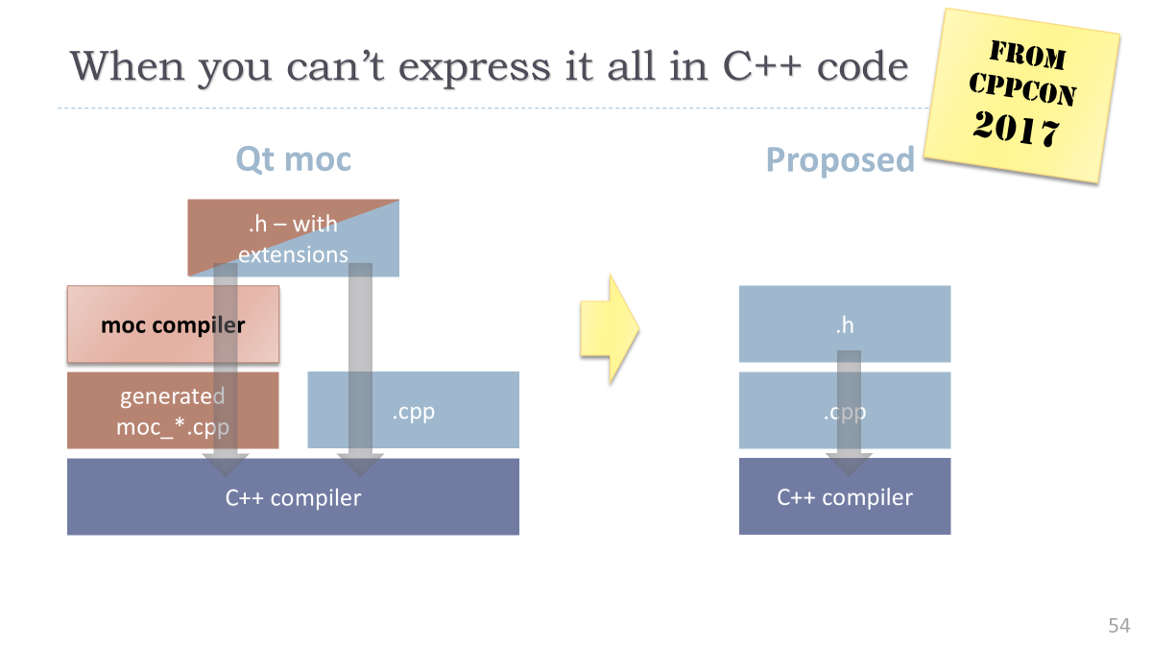
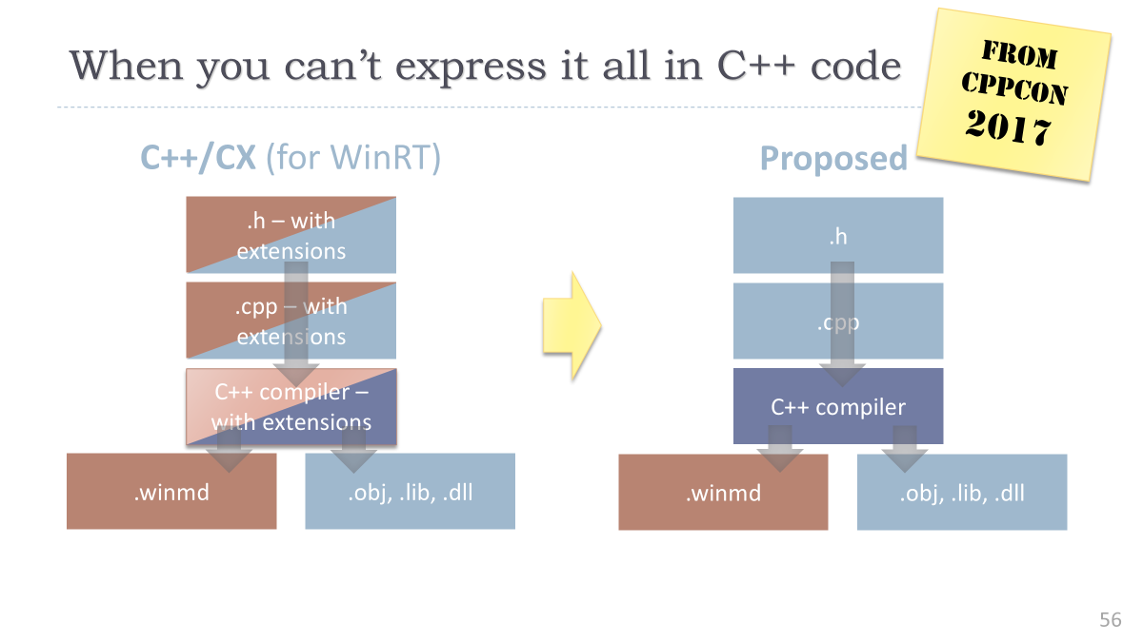
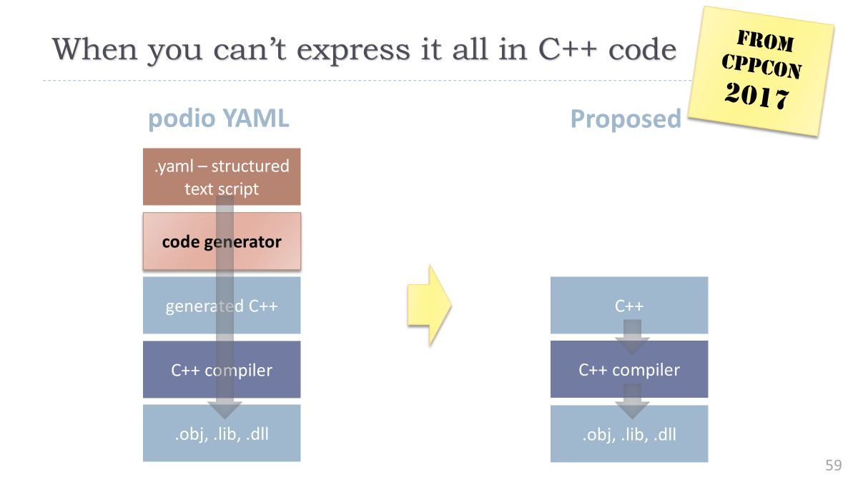
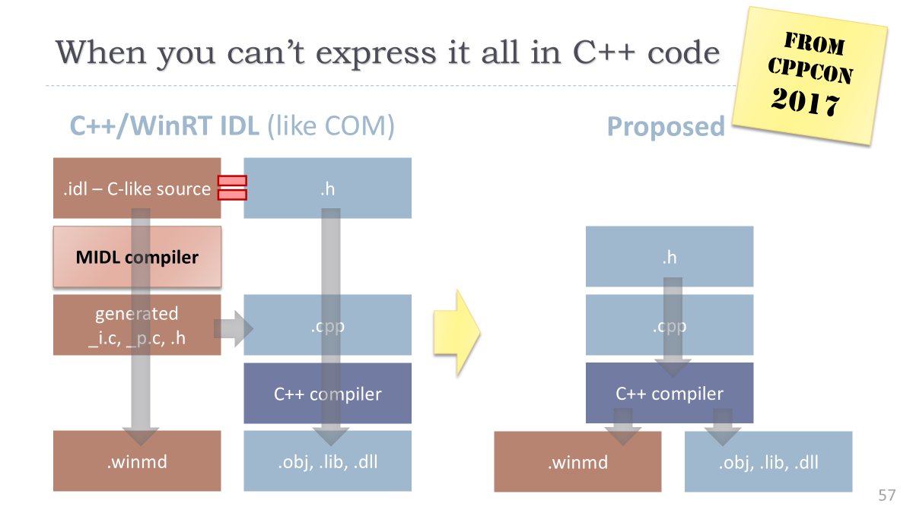
A funny thing happened on the way to the elevator…

Slide 42
One last example: #embed + [:splice:]
Example by Dan Katz…
C++26 program
test.json
int main() {
constexpr const char json [] = {
#embed "test.json"
, 0
};
constexpr auto v = [:parse_json(json):];
std::println(" field: {}\n number: {}",
v.inner.field, v.inner.number);
}
{ "outer": "text", "inner": { "field": "yes", "number": 2996 } }
output
field: yes
number: 2996

Slide 43
Welcome to C++’s next decade!
Conjecture: Reflection+generation will dominate the next decade of C++
Making easier things that are difficult today (e.g., TMP, expression templates)
Making possible things that are infeasible today (e.g., generative programming)
Expect multiple phases… the first phase was added to draft Standard C++ 48 hours ago

Slide 44
Three Cool Things in C++
Thing 2
Thing 1
≈ £0
Thing 3
Thing 3
Thing 3
Thing 3
Thing 3

Slide 45
Three Cool Things in C++
Thing 2
Thing 1
≈ £0
Thing 3
Thing 3
Thing 3
Thing 3
Thing 3

Slide 46
Sync → async
A simple synchronous call
int result = f(x,y,z); // call + get result – blocks
// ::: code here runs after f :::
use_result( result ); // never blocks
A simple asynchronous call — decouple launch/join
future<int> result = pool.run( [=]{ return f(x,y,z); }); // call (only) – no blocking
// ::: code here runs potentially concurrently with f :::
use_result( result.value() ); // get result – might block
A simple asynchronous call with P2300 std::execution
auto work = schedule(pool) | then([=]{ return f(x,y,z); }); // call (only) – no blocking
// ::: code here runs potentially concurrently with f :::
auto [result] = sync_wait(work).value(); // get result – might block use_result(result);
godbolt.org/z/TMbjfhq8K

Slide 47
Concurrency vs Parallelsm
 | I. Concurrency for isolation | II. Parallelism for scalability
Tagline | Keep things separate | Re-enable the free lunch
Summary | Stay responsive and avoid blocking by run-ning tasks in isolation and communicating via messages | Use more cores to get the answer faster by running operations on groups of things; exploit parallelism in data/algorithm structures
Examples | GUIs, web services, bkgd print/compile | Trees, quicksort, compilation
Key metrics | Responsiveness, latency hiding | Throughput, scalability
Requirements | Isolated, independent | Low overhead, side effect free
Old tools & abstractions | Threads, message queues, OpenMPI | Thread pools, OpenMP
New tools & abstractions | Active objects, futures | Work stealing runtimes
Surprise (to me!)
That a single async framework can handle both well
Jessica Wong: “use the same code for SIMD and CPU”
… and GPU

Slide 48
Three Cool Things in C++
Thing 2
Thing 1
≈ £0
Thing 3
Thing 3
Thing 3
Thing 3
Thing 3

